Slide 1
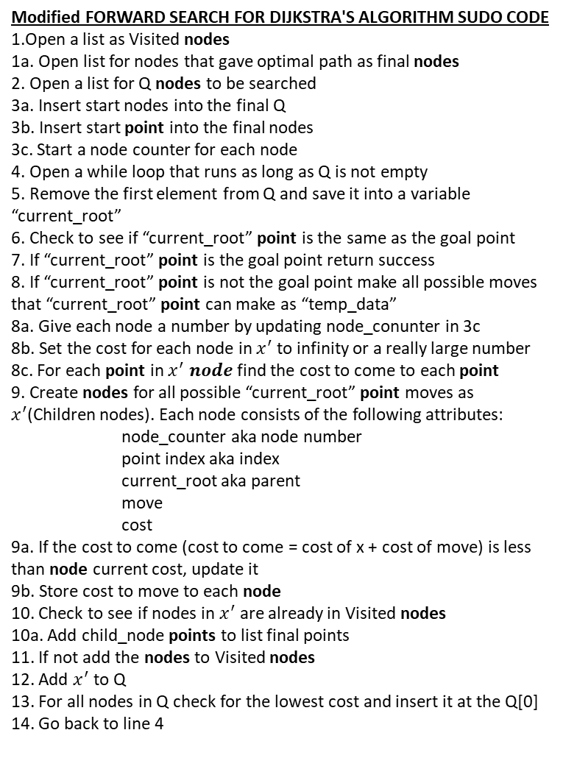
Modified FORWARD SEARCH FOR DIJKSTRA'S ALGORITHM SUDO CODE
1.Open a list as Visited nodes
1a. Open list for nodes that gave optimal path as final nodes
2. Open a list for Q nodes to be searched
3a. Insert start nodes into the final Q
3b. Insert start point into the final nodes
3c. Start a node counter for each node
4. Open a while loop that runs as long as Q is not empty
5. Remove the first element from Q and save it into a variable “current_root”
6. Check to see if “current_root” point is the same as the goal point
7. If “current_root” point is the goal point return success
8. If “current_root” point is not the goal point make all possible moves that “current_root” point can make as “temp_data”
8a. Give each node a number by updating node_conunter in 3c
8b. Set the cost for each node in $x^{′}$ to infinity or a really large number
8c. For each point in $x^{′} node$ find the cost to come to each point
9. Create nodes for all possible “current_root” point moves as $x^{′}$(Children nodes). Each node consists of the following attributes:
node_counter aka node number
point index aka index
current_root aka parent
move
cost
9a. If the cost to come (cost to come = cost of x + cost of move) is less than node current cost, update it
9b. Store cost to move to each node
10. Check to see if nodes in $x^{′}$ are already in Visited nodes
10a. Add child_node points to list final points
11. If not add the nodes to Visited nodes
12. Add $x^{′}$ to Q
13. For all nodes in Q check for the lowest cost and insert it at the Q[0]
14. Go back to line 4
def exploring_nodes(node):
print("Exploring Nodes")
actions = ["down", "up", "left", "right","down_right", "up_right", "down_left", "up_left"]
goal_node = get_goal_node()
node_q = [node] #2 and 3a
final_nodes = [] #1a
visited = [] #1
final_nodes.append(node_q[0].data.tolist()) # 3b
node_counter = 0 # 3c
while node_q: #4
current_root = node_q.pop(0) # 5
if current_root.data.tolist() == goal_node.tolist(): #6
print("Goal reached")#7
return current_root, final_nodes, visited#7
for move in actions:
temp_data = move_tile(move, current_root.data)#8
if temp_data is not None:
node_counter += 1 #8a
node_cost=20000000000000 #8b
cost_to_come= current_root.cost + move_cost(move)#8c
child_node = Node(node_counter, np.array(temp_data), current_root, move, node_cost) # 9
if node_cost > cost_to_come : #9a
child_node.cost= cost_to_come# 9b
if child_node.data.tolist() not in final_nodes: # Add the child node data in final node list #10
node_q.append(child_node) #12
final_nodes.append(child_node.data.tolist()) #10a
visited.append(child_node)#11
for all bodies in node-q: #13
node_cost_list=[] #13
if bodies.cost is min(bodies.cost):#13
node_q.insert(0,bodies) #13
return None, None, None # return statement if the goal node is not reached#14

